Slide 1


NBTC – ITU Training
on Building IoT solutions for e-applications
Session 1: Convergence: Trends, Issues And Challenges

Slide 2


















Goals for a Sustainable Future : The SDGs
Notes:
The SDGThe 17 goals and 169 targets, known collectively as the SDGs, which came into effect on 1 January 2016, do not only replace the MDGs, but build on them, making them more “integrated and indivisible”.
While the MDGs represented a more limited set of goals towards poverty eradication, education, and good health, the SDGs cover economic, social, and environmental pillars of sustainable development, universally applicable in all countries.
The SDGs are intended to be aspirational and action-oriented. Equally important is the need to assess progress towards the achievement of the goals, accompanied by targets and indicators.
Although the target date for the SDGs is the year 2030, certain targets are expected to be met along the way with some as early as 2017 or 2020

Slide 3
What type of network is required to deliver Mission Critical services?
Private networks
Public networks
What preparations are required to make best use of commercial networks to deliver smart services (some of them such as Emergency Telecommunication, Utilities, Transportation critical in character)?
Technical (e.g. coverage, resilience, quality, spectrum, interoperability)
Commercial (e.g. availability, long term pricing, SLAs)
Policy & Regulatory (e.g. critical services as priority, quality of service, long term tariffs, security, privacy, USO, infrastructure sharing, licensing)

Slide 4
IOT and regulatory issues
Spectrum
Traffic and spectrum availability
Licensing (Allocation method, terms and conditions, technology aspects, license period)
Technical (Low range, high
Energy Efficiency (e.g. Battery Life)
Commercial
WRC 2019 and IMT Spectrum
Source: BEREC Report “Enabling the Internet of Things”12 February 2016,

Slide 5
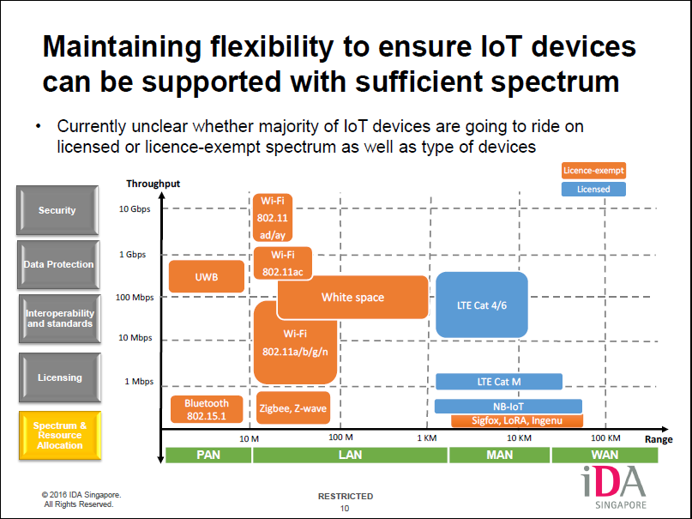

Slide 6
IOT and regulatory issues
PRIVACY AND SECURITY ISSUES: Potential regulatory measures
R&D on more hardware and software security and privacy mechanisms for resource‐constrained IoT systems, particularly targeted towards start‐ups and individual entrepreneurs that lack resources to easily develop this functionality.
Incentives for companies to develop new mechanisms to improve transparency of IoT personal data use, and for gaining informed consent from individuals concerned when sensitive data is gathered or inferences drawn.
Greater use of Privacy Impact Assessments by organisations building and configuring IoT systems.
Development of further guidance from global privacy regulators on application of the principles of data minimisation and purpose limitation in IoT systems.
More cooperation between telecoms and other regulators such as privacy/data protection agencies.
Source: GSR discussion paper Regulation and the Internet of Things, 2015

Slide 7
Security and privacy protection capabilities
The security and privacy protection group includes communication security capability, data management security capability, service provision security capability, security integration capability, mutual authentication and authorization capability, and security audit capability.
Communication security capability involves the abilities of supporting secure, trusted and privacy-protected communication [C-7-1].
Data management security capability involves the abilities of providing secure, trusted and privacy-protected data management [C-7-2].
Service provision security capability involves the abilities of providing secure, trusted and privacy-protected service provision [C-7-3].
Security integration capability involves the abilities of integrating different security policies and techniques related to the variety of IoT functional components [C-7-4].
Mutual authentication and authorization capability involves the abilities of authenticating and authorizing each other before a device accesses the IoT based on predefined security policies [C-7-5].
Security audit capability involves the abilities of monitoring any data access or attempt to access IoT applications in a fully transparent, traceable and reproducible way based on appropriate regulation and laws [C-7-6].
NOTE – These security and privacy protection capabilities include also the ability of coping with the security and privacy protection issues for operations across different domains.
Source: Recommendation ITU-T Y.4401/Y.2068 (03/2015))
Please refer Annex A Recommendation ITU-T Y.4401/Y.2068 for the IoT capabilities list

Slide 8
IOT and regulatory issues
INTEROPERABILITY AND STANDARDS
IoTs have both public and proprietary standards currently
Standardization is important for Interoperability, reducing costs and barriers to entry
  ITU-T SG 20 (IOT and Smart Cities, Smart Communities)
  National Standardization bodies
  International Standardization bodies
How to coordinate interoperability amongst public and private sector entities?
e.g. parking meters, thermostats, cardiac monitors, tires, roads, car components, supermarket shelves
Cross-sectoral collaboration is very important as IoT are deployed in multiple sectors

Slide 9
IOT and regulatory issues
Competition issues
Licensed Vs Non Licensed services
Area of license
OTT
Net Neutrality
Infrastructure sharing
Access to data and open IOT platforms
Data analytics
Customer lock-in
Mobile data roaming
Consumer protection
Quality of Service
USO

Slide 10
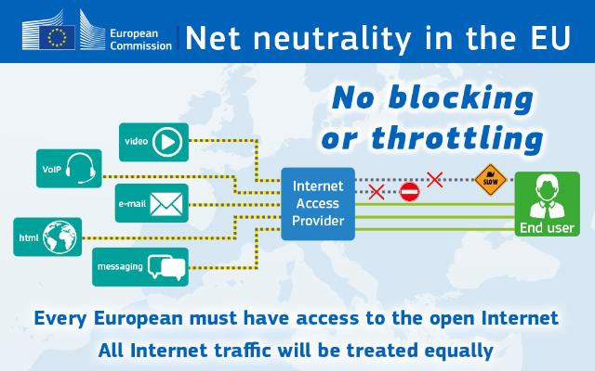
Net Neutrality: Europe Union
Article 3
Safeguarding of open internet access
Article 4
Transparency measures for ensuring open internet access
Article 5
Supervision and enforcement
Article 6
Penalties
REGULATION (EU) 2015/2120 OF THE EUROPEAN PARLIAMENT AND OF THE COUNCIL of 25 November 2015
laying down measures concerning open internet access and amending Directive 2002/22/EC on universal service and users’ rights relating to electronic communications networks and services and Regulation (EU) No 531/2012 on roaming on public mobile communications networks within the Union

Slide 11
Thank You

